Slide 1
Complexity Analysis

Slide 2
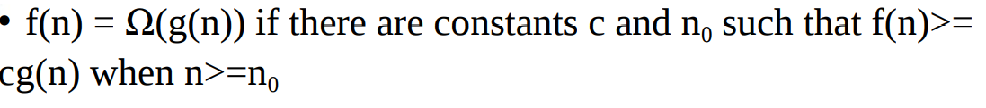
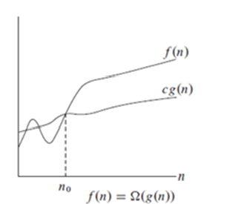
Asymptotic Complexity Analysis: Ω
Let f(n) be the running time for an algorithm

Slide 3
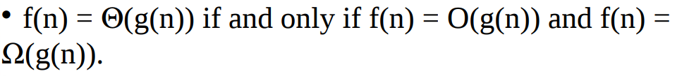
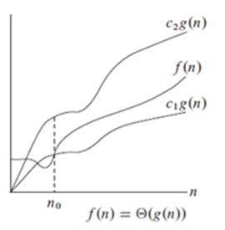
Asymptotic Complexity Analysis: θ
Let f(n) be the running time for an algorithm
c₁g (n) <=f(n) <= c₂g (n)
NOTE:
g(n) here is same on
both the sides.
Left side represents Ω while right side represents θ
Inference:
Θ exists only when
Ω(g(n) Ո O(g(n) ≠ φ

Slide 4
Problem
Let t(n)=3n³ + 20n² + 5 for an algorithm. Express in terms of Big(O), Big(Ω)
and Big (θ)

Slide 5
Problem
Let t(n)=3n³ + 20n² + 5 for an algorithm.
3n³ <= (3n³ + 20n² + 5) <= (3+20+5) n³
3n³ <= (3n³ + 20n² + 5) <= (28) n³
C1=3 and c2=28 ; Constant terms.
Hence proved

Slide 6
Problem Solving
Let t(n)=3n³ + 20n² + 5 for an algorithm.
3n³ < (3n³ + 20n² + 5) <= (3+20+5) n³
3n³ < (3n³ + 20n² + 5) <= (28) n³
C1=3 ; Constant term.
Hence proved
Let t(n) be running time for an algorithm.and its lower bound is
T(n) >= 2n² + 1 and its upper bound is T(n) <= 20n² + 5n+8
Express in terms of Big(O), Big(Ω)
and Big (θ)
Express in terms of Big(O), Big(Ω) and Big (θ), f(n)=2+1/n
2<= f(n) <=3 ; n>=1

Slide 7
Problem Solving
Let t(n)=3n³ + 20n² + 5 for an algorithm.
3n³ < (3n³ + 20n² + 5) <= (3+20+5) n³
3n³ < (3n³ + 20n² + 5) <= (28) n³
C1=3 ; Constant term.
Hence proved
Let t(n) be running time for an algorithm.and its lower bound is
T(n) >= 2n² + 1 and its upper bound is T(n) <= 20n² + 5n+8
Express in terms of Big(O), Big(Ω)
and Big (θ)
2n² <= 2n² +1 <= 3n²
20n² <= 20n² + 5n+8 <= 33 n^2
Hence θ(n^2)

Slide 8
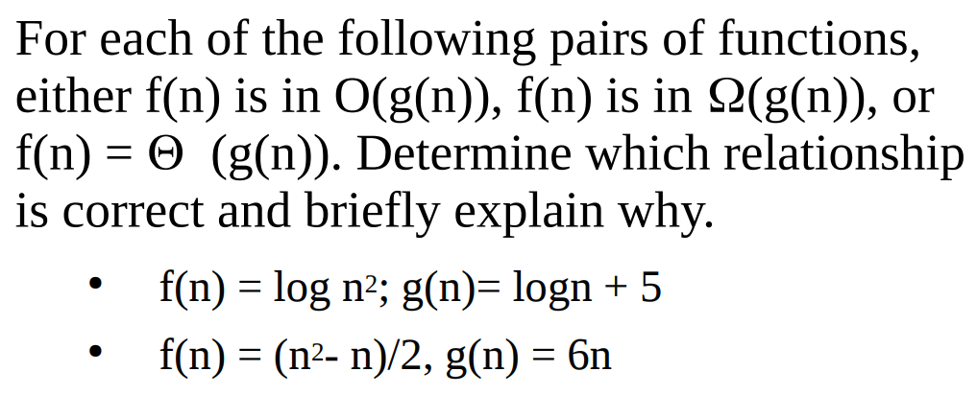
Problem Solving: homework
Comment on complexity of T(n)=1+2+3+.....+n
in terms of θ, Ω and O

Slide 9
Properties of BIG(O)

Slide 10





Properties of BIG(O): Example

Slide 11


Problem Solving
????
????
Own understanding:
Analyze complexity of bubble sort and merge sort by counting primitive functions.

